Slide 1
Relativity and E&M
Eric Prebys, UC Davis

Slide 2
This Lecture
Math Refresher (Expectations)
Maxwell’s Equations
Special Relativity
Multipole Expansion of Magnetic Fields

Slide 3
Expectations: Basics and Refreshers
Matrix Operations

Slide 4
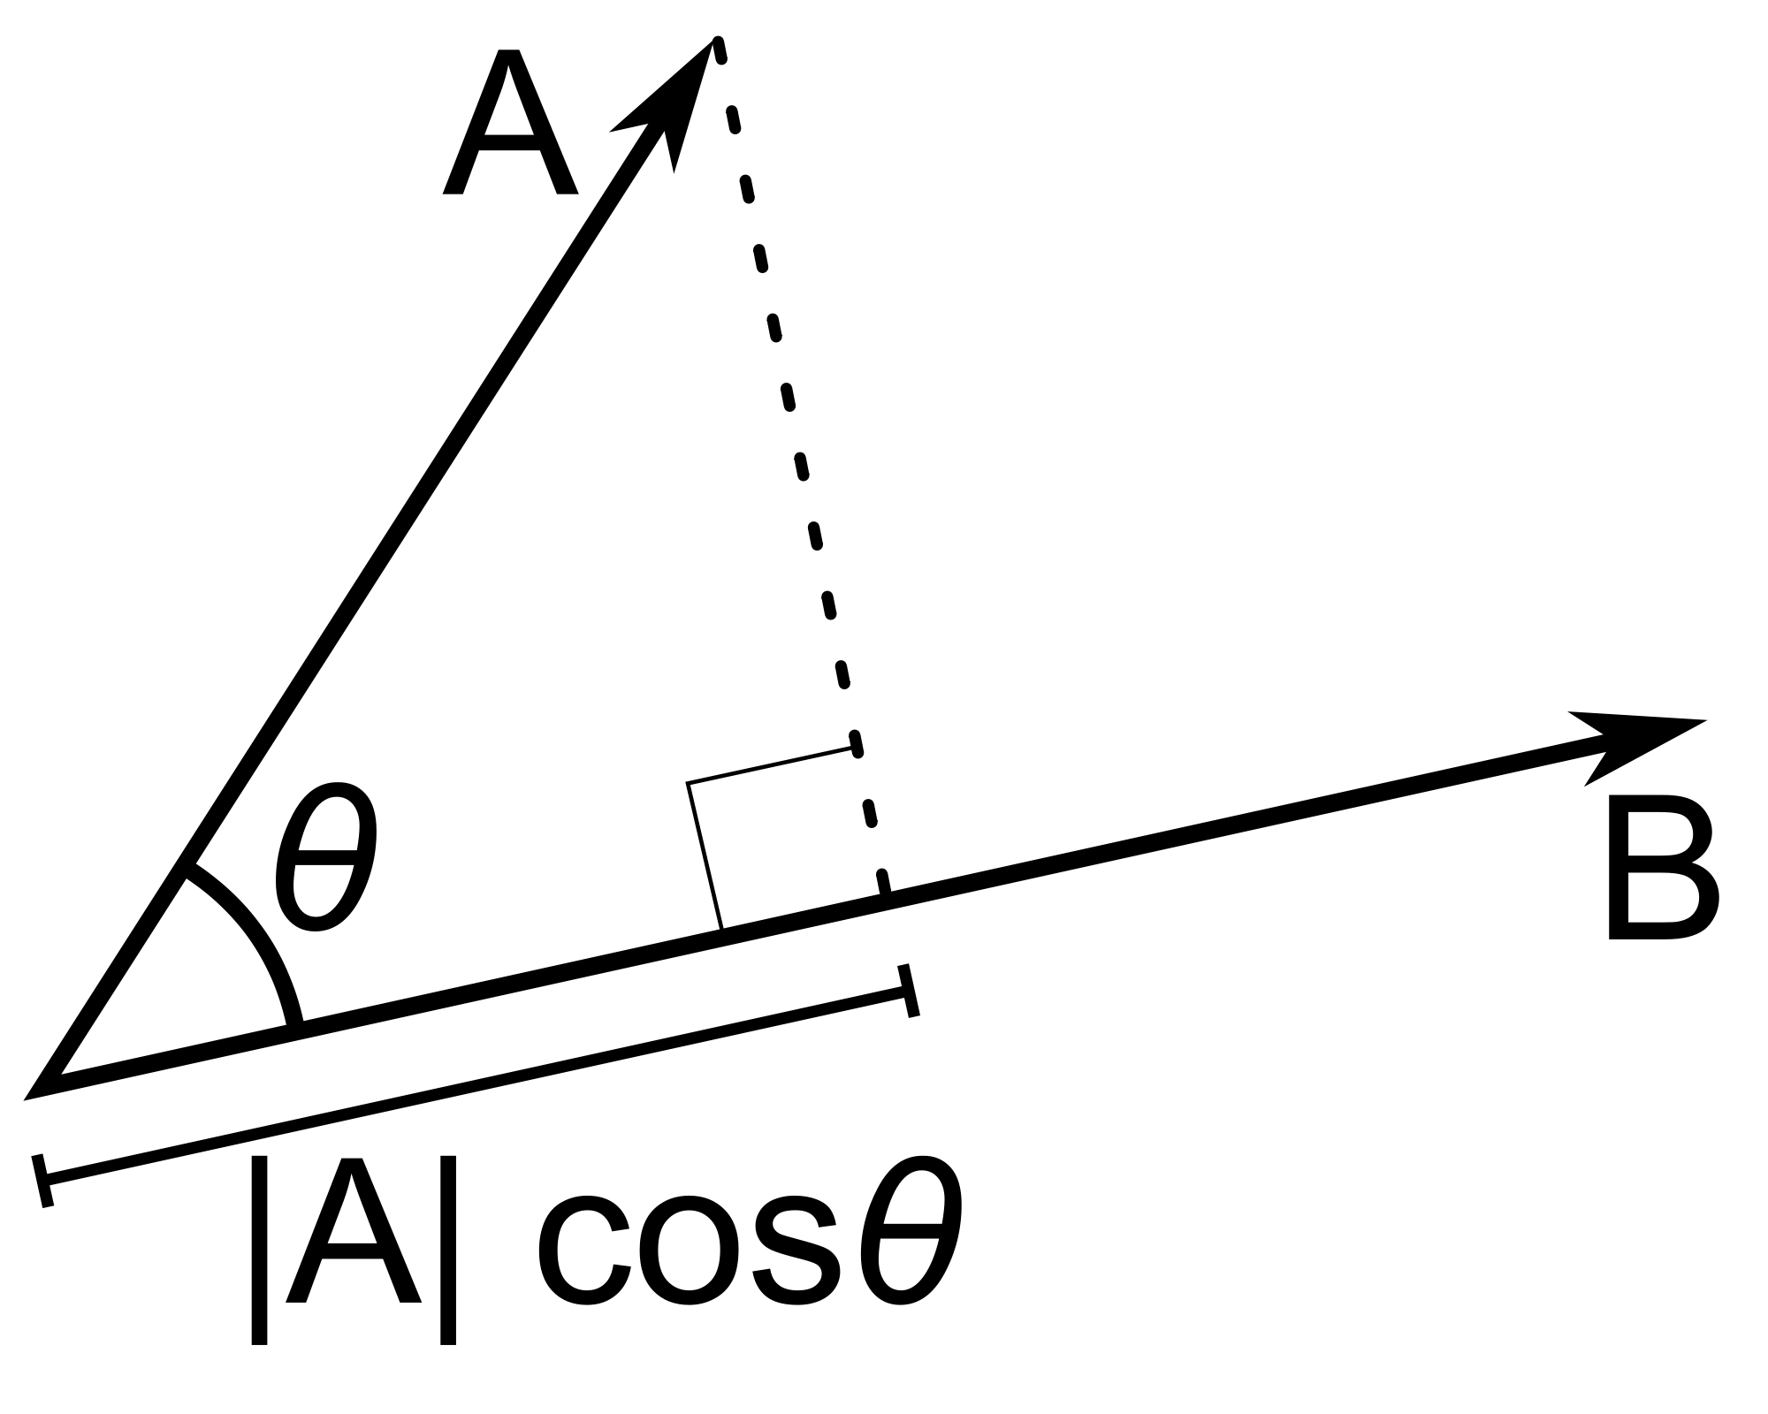
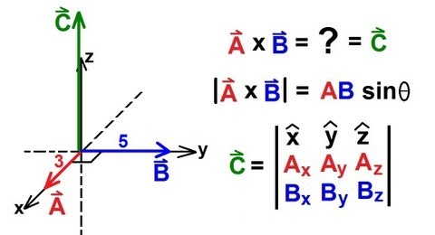
Expectations (cont’d)
Vector Operations
Dot product
Cross product

Slide 5
Expectations (cont’d)
Vector differential operations
Grad operator
Gradient
Divergence
Curl

Slide 6
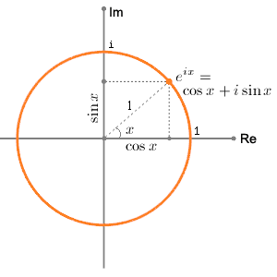
Euler Relations
You should be very comfortable with the complex plane
Also remember the Taylor expansions of trig functions

Slide 7
Some Handy Relationships
Memorize these because we’ll use them a lot!

Slide 8
Maxwell’s Equations
In 1861, James Maxwell began his attempt to find a self-consistent set of equations consistent with all of the E&M experiments which had been done up until that point.
Because vector calculus hadn’t been invented yet, his final paper is 55 pages long and completely incomprehensible.
In in modern notation, it reduces to the following four equations:

Slide 9
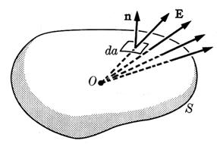
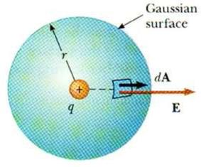
Gauss’ Law
The electric field passing through a surface depends only on the charge contained within the surface
Example: deriving Coulomb’s Law

Slide 10
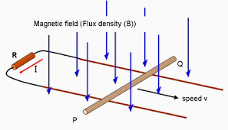
Faraday’s Law
The integrated electric field around any closed loop is proportional to the rate of change of the magnetic flux passing through the loop
Example: magnetic induction

Slide 11
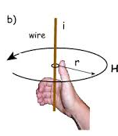
Ampere’s Law
The integrated magnetic field around any closed loop is proportional to the total current passing through the loop.
Example: Magnetic field of a wire
Set to 0 for a minute

Slide 12
Displacement Current
Maxwell’s first version of Ampere’s Law did not have the second term
However, you should be able to draw the surface anywhere, and you get in trouble if you draw it through a break in the current
Maxwell added the second term just so he would get the same answer in both cases!
However, anywhere there’s a break in the current, you’ll get a changing electric field.

Slide 13
Electromagnetic Waves
The “displacement current” was added for purely mathematical reasons
It would not be proven experimentally for many years
However, the implications were profound
Previously, it was believed you could not have electric or magnetic fields without electric charges, but now, even in a complete vacuum, you can have
(changing electric field)➔(changing magnetic field)➔ (changing electric field)➔Electromagnetic Wave”!
Moreover, Maxwell could calculate the velocity, and he found it was the speed of light!
He wrote (with trembling hands, maybe?) "we can scarcely avoid the inference that light consists in the transverse undulations of the same medium which is the cause of electric and magnetic phenomena"

Slide 14
It’s all the same thing…
In one fell swoop, Maxwell not only unified electricity and magnetism, but his results would eventually show that light, heat, radio waves, x-rays, gamma rays, etc., are all really the same thing – differing only in wavelength!
The entire visible spectrum.

Slide 15
What’s “undulating”?
As often happens science, one answer raised a lot more questions.
All (other) known waves require a “medium” (air, water, earth, “the wave”) to travel through.
Light at least appears to travel through a vacuum.
In science, always try the simplest answer first:
Maybe vacuum isn’t really empty?
Scientists hypothesized the existence of “luminiferous aether”, and started to look for it…

Slide 16
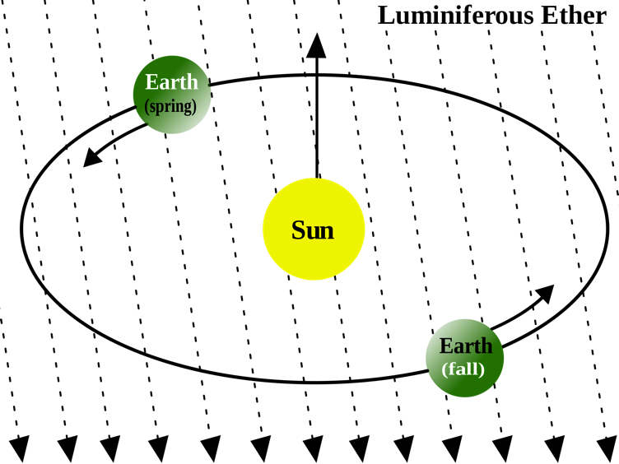
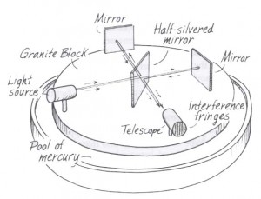
Michelson-Morley Experiment
If aether exists, then it must fill space and the earth must be passing through it.
Light traveling along the direction of the Earth’s motion should have a slightly different wavelength than light traveling transverse to it.
In 1887, Albert Michelson and Edward Morley performed a sensitive experiment to measure this difference.
Their result:
No difference ➔ no aether!
Biggest mystery in science for almost 20 years.

Slide 17
Einstein to the Rescue
In 1905, Albert Einstein postulated that perhaps the equations meant exactly what they appeared to mean:
The speed of light was the same in any frame in which is was measured.
He showed that this could “work”, but only if you gave up the notion of fixed time.
➔ “Special Theory of Relativity”
Profound implications…

Slide 18
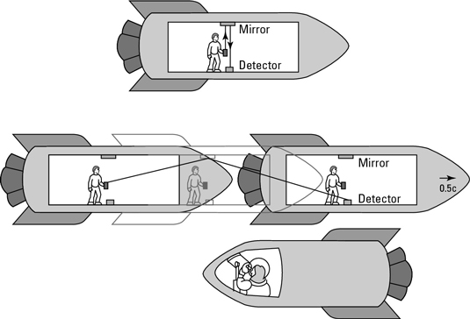
Example: Time Dilation
Einstein said, “The speed of light must be the same in any reference frame”. For example, the time it takes light to bounce off a mirror in a spaceship must be the same whether it’s measured by someone in the spaceship, or someone outside of the spaceship.
This seems weird, but it applies to everything we do at the lab
Example: the faster pions and muons move, the longer they live.
These two people have to measure the same speed for light, even though light is traveling a different distance for the two of them.
The only solution? More time passes for the stationary observer than the guy in the spaceship!
“Twin Paradox”

Slide 19
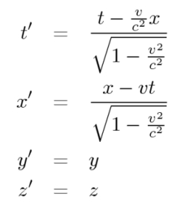
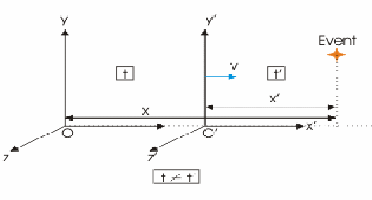
Lorentz Transformations
Generally, relativity treats time more or less like one more spatial dimension. Both time and space transform between two frames

Slide 20
Momentum and Energy in Special Relativity
Classically:
Relativistically:

Slide 21
Notation and Formalism
Some Handy Relationships (homework)
Basics
A word about units
For the most part, we will use SI units, except
Energy: eV (keV, MeV, etc) [1 eV = 1.6x10⁻¹⁹ J]
Mass: eV/c² [proton = 1.67x10⁻²⁷ kg = 938 MeV/c²]
Momentum: eV/c [proton @ β=.9 = 1.94 GeV/c]

Slide 22
4-Vectors and Lorentz Transformations
We’ll use the conventions
Note that for a system of particles
We’ll worry about field transformations later, as needed

Slide 23
Back to Maxwell’s Equation: EM Fields in Matter
The equations we’ve talked about so far are correct if you account for all electric charges in the system; however, in real life situation, much, or even most, of the charge is a system is contained in matter, and it’s behavior can generally be parameterized in a more convenient way. In terms of just the free electric charge, Gauss’ Law and Ampere’s Law become: where
Local effects of media

Slide 24
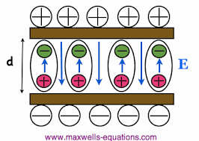
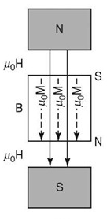
Fields in Matter
The “electric permittivity” comes from the tendency of charge in matter to form electric dipoles in the presence of an external field, reducing the the true field
The “magnetic permeability” comes from the tendency of magnetic dipoles in some materials to align with the external magnetic field, increasing the true field.

Slide 25
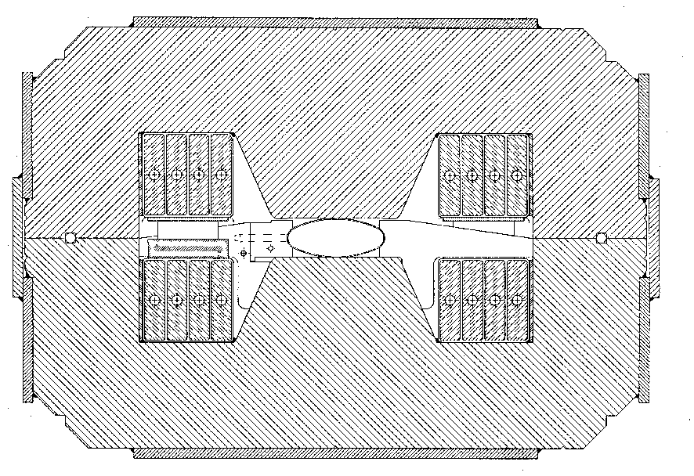
Example: Field in a permeable dipole
Cross section of dipole magnet
Integration loop
g

Slide 26
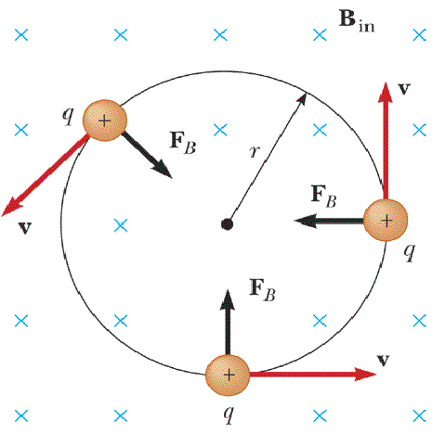
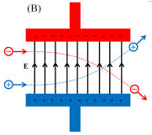
Particle Motion in EM Fields
The relativistially correct form for the motion of charged particles in electric and magnetic fields is given by the Lorentz equation:

Slide 27
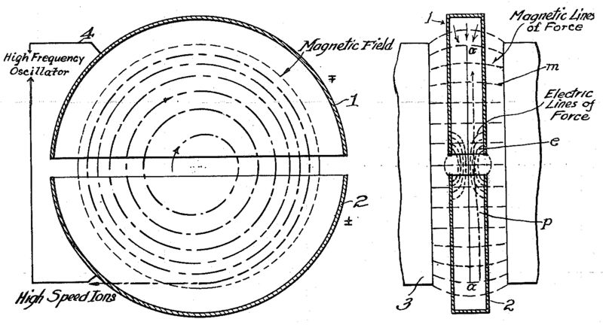
Cyclotron (1930’s)
side view
top view
A charged particle in a uniform magnetic field will follow a circular path of radius
“Cyclotron Frequency”
For a proton:
Accelerating “DEES”

Slide 28
Understanding Beam Motion: Beam “rigidity”
The relativistically correct form of Newton’s Laws for a particle in an electromagnetic field is:
A particle of unit charge in a uniform magnetic field will move in a circle of radius
side view
top view
constant for fixed energy!
T-m²/s=V
units of eV in our usual convention
Beam “rigidity” = constant at a given momentum (even when B=0!)
Remember forever!
If all magnetic fields are scaled with the momentum as particles accelerate, the trajectories remain the same
➔“synchrotron” [E. McMillan, 1945]

Slide 29
Example Beam Parameters
Compare Fermilab LINAC (K=400 MeV) to LHC (K=7000 GeV)
Parameter | Symbol | Equation | Injection | Extraction
proton mass | m [GeV/c²] |  | 0.938
kinetic energy | K [GeV] |  | .4 | 7000
total energy | E [GeV] |  | 1.3382 | 7000.938
momentum | p [GeV/c] |  | 0.95426 | 7000.938
rel. beta | β |  | 0.713 | 0.999999991
rel. gamma | γ |  | 1.426 | 7461.5
beta-gamma | βγ |  | 1.017 | 7461.5
rigidity | (Bρ) [T-m] |  | 3.18 | 23353.
This would be the radius of curvature in a 1 T magnetic field or the field in Tesla needed to give a 1 m radius of curvature.

Slide 30
Thin lens approximation and magnetic “kick”
If the path length through a transverse magnetic field is short compared to the bend radius of the particle, then we can think of the particle receiving a transverse “kick” and it will be bent through small angle
In this “thin lens approximation”, a dipole is the equivalent of a prism in classical optics.

Slide 31
Some Formalism (sorry)
Define the “gradient” operator

Slide 32
Field Multipole Expansion
Formally, in a current free region, the curl of the magnetic field is:
This means that the magnetic field can be expressed as the gradient of a scalar:
The zero divergence then gives us:
If the field is uniform in z, then δφ/δz=0, so
Laplace Equation

Slide 33
The general solution is
Solving for B components
Combining and redefining the constants
Note order!

Slide 34
We can express the complex numbers in notation
K_{n} is complex
r is real
Amplitude
rotation

Slide 35
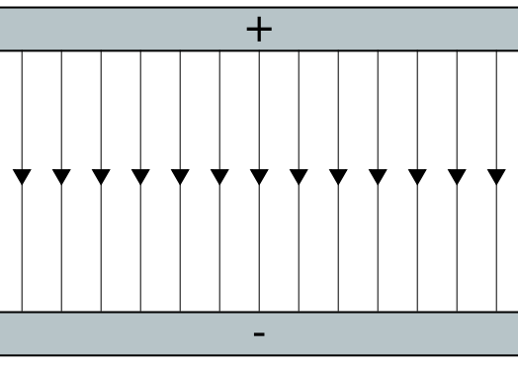
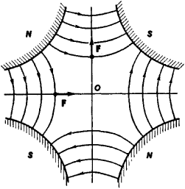
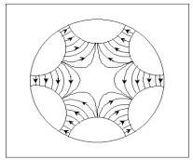
In our general expression
the phase angle δ_{m} represents a rotation of each component about the z axis. Set all δ_{m} =0 for the moment, and we see the following symmetry properties for the first few multipoles

Slide 36
Back to Cartesian Coordinates. Expand by differentiating both sides n times wrt x
And we can rewrite this as
“Normal” terms always have B_{x}=0 on x axis.
“Skew” terms always have B_{y}=0 on x axis.
Generally define
“normal”
“skew”

Slide 37
Expand first few terms…
Note: in the absence of skew terms, on the x axis
dipole
quadrupole
sextupole
dipole
quadrupole
sextupole
octupole

Slide 38
Summary of Multipoles
The n^{th} term in the expansion will have 2(n+1) alternating N and S poles, separated by π/(n+1) angles
Along the x axis
Normal
Skew
…
…
…
…

Slide 39
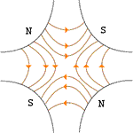
Application of Multipoles
Dipoles: bend
Quadrupoles: focus or defocus
A positive particle coming out of the page off center in the horizontal plane will experience a restoring kick

Slide 40
Sextupoles Octupoles
Sextupole magnets have a field (on the principle axis) given by
One common application of this is to provide an effective position-dependent gradient.
In a similar way, octupoles have a field given by
So high amplitude particles will see a different average gradiant

